Slide 1
Multisensor Process Performance Assessment Through the Use of Autoregressive Modeling and Feature Maps
by
N. Casoetto, D. Djurdjanovic, R. Mayor, J. Lee and J. Ni

Slide 2
Outline of the Presentation
Introduction
Methods
  Spectral Estimation Using Autoregressive Modeling
  Performance Assessment Using a Feature Map
Experimental Results
Discussion
Summary

Slide 3
INTRODUCTION
Notes:
Ladies and Gentleman ; Good (Morning Afternoon)!
I am Xue Wang from Tsinghua University , China . Now, I am a visitor scholar in IMS Center UWM.
Today, My presentation topic is Prognostic and Diagnostic

Slide 4

Condition Based Maintenance (CBM) Paradigm
Normal Behavior
Most Recent Behavior
Most Recent Behavior
Quantitative Health Assessment
Feature Space
Data
Normal Behavior
Most Recent Behavior
Faulty Behavior
Information
Condition Diagnosis
Feature Space
Normal Behavior
Model of a Fault
Decisions
Performance Prediction
Predicted Probability of Failure
Feature f₂
Prediction Uncertainty
Predicted Health
Feature f₁

Slide 5
METHODS
Notes:
Ladies and Gentleman ; Good (Morning Afternoon)!
I am Xue Wang from Tsinghua University , China . Now, I am a visitor scholar in IMS Center UWM.
Today, My presentation topic is Prognostic and Diagnostic

Slide 6
Performance Assessment Using Autoregressive (AR) Modeling and Feature Maps
Time series data / multi-sensor input.
Fit AR Models to sensory inputs
Extract spectral peaks
Training of the Feature Map
Performance Evaluation
Training period
Performance assessment
Teach the Feature Map to recognize Power-Spectral Density (PSD) peaks characterizing normal behavior
Quantitative comparison of the newly arrived Power-Spectral Density (PSD) peaks with those observed during normal behavior

Slide 7
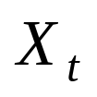
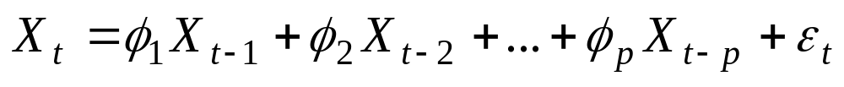


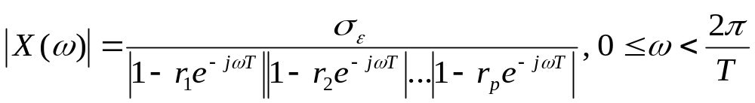



Autoregressive Modeling and Spectral Estimation
- Sensor reading at time t.
- Parameters of the AR model
- Residual modeling noise
- Discrete Fourier transform of the signal
- Roots of the Autoregressive characteristic equation
- Sampling interval

Slide 8
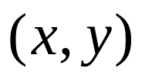
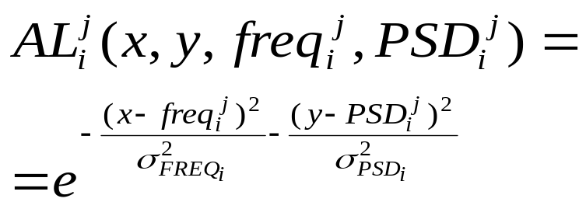

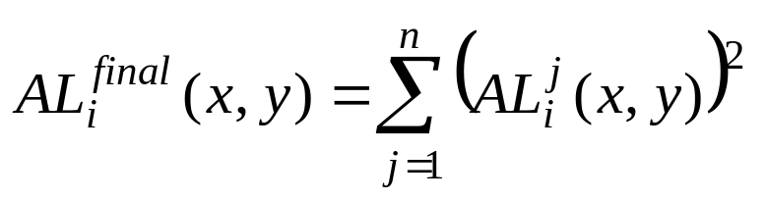




Feature Map Training
PSD peak intensity
Cell
AR
root
2-D Gaussian function
Activation Level
PSD peak
frequency
0
Frequency of the PSD peak i for training signal j
Intensity of the PSD peak i for training signal j
Frequency variance of the PSD peak i
Number of training signals
Frequency variance of the PSD peak i

Slide 9
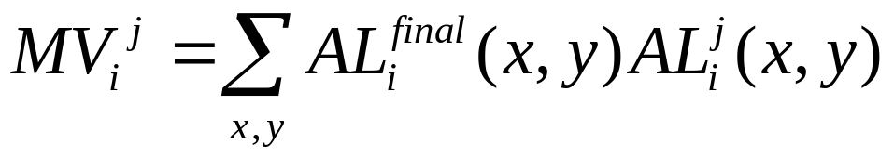
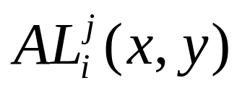
Feature Map Based Performance Assessment
PSD peak intensity
New PSD peak
Training PSD peak
Learned 2-D Gaussian
function
New 2-D normal
function
PSD peak
frequency
0
Match Value for peak i of the new signal j
Activation level for peak i of the new signal j
Performance Confidence Value (CV) is assessed as the average Match Value for all PSD peaks

Slide 10
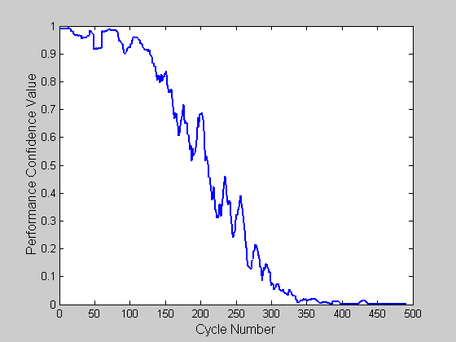
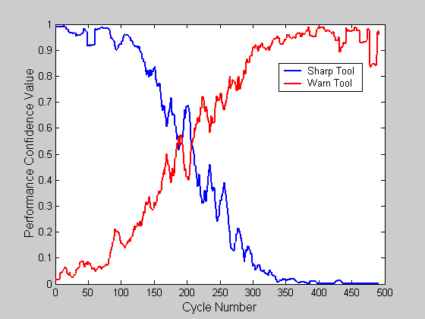
Degradation Assessment
Performance
Confidence
Value
Normal Behavior
Most Recent Behavior
Most Recent Behavior
Feature Space
Normal Behavior
Most Recent Behavior
Faulty Behavior
Feature Space

Slide 11
RESULTS
Notes:
Ladies and Gentleman ; Good (Morning Afternoon)!
I am Xue Wang from Tsinghua University , China . Now, I am a visitor scholar in IMS Center UWM.
Today, My presentation topic is Prognostic and Diagnostic

Slide 12
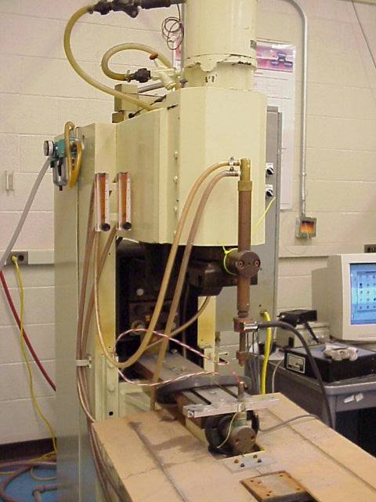


Experimental Setup
Ø 6mm conical brass electrodes
3550 Welds
Force, Current and Voltage Sensor Readings

Slide 13
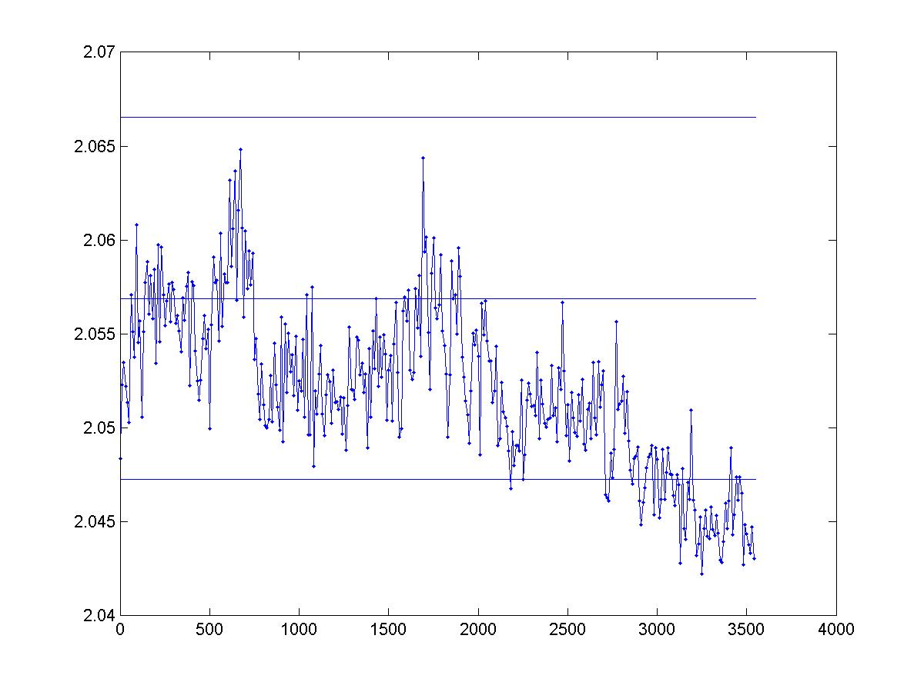
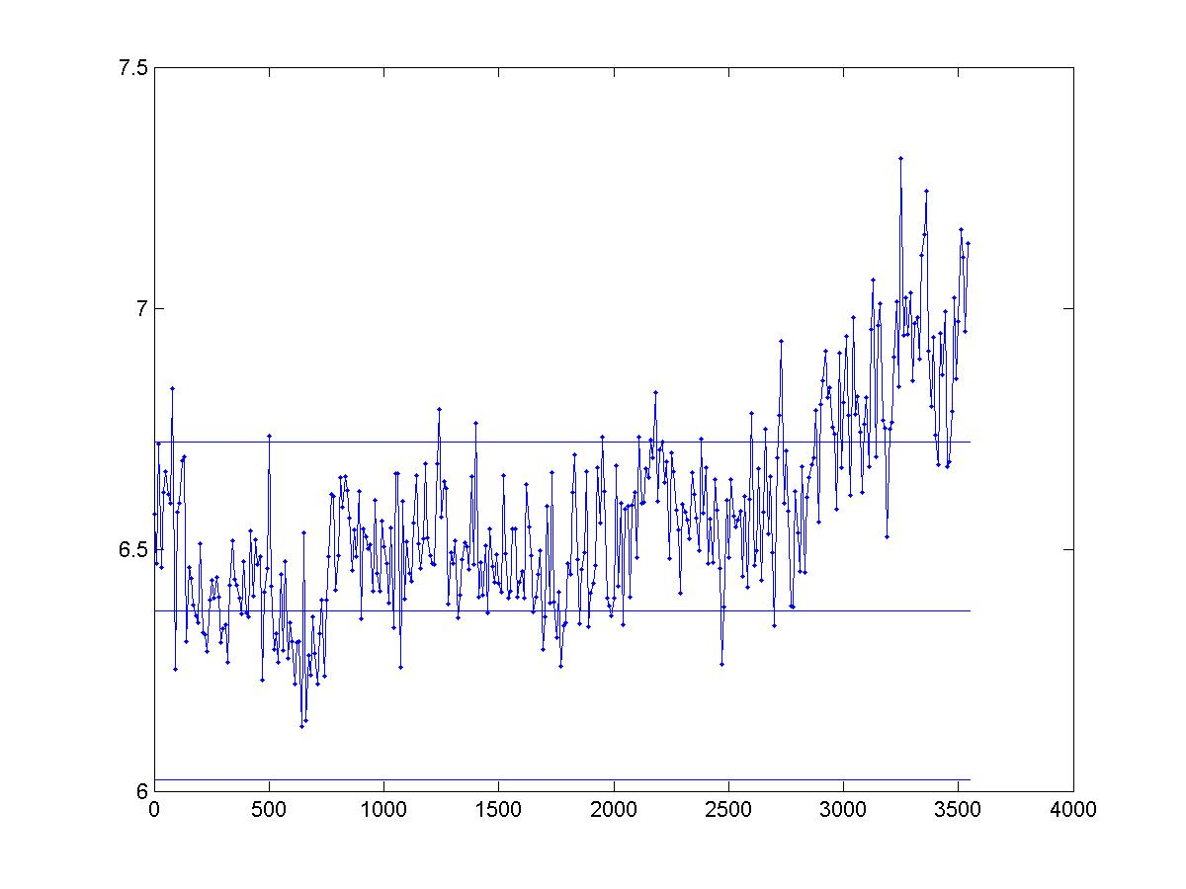
Evolution of PSD Peaks
Frequency of Peak No. 16 (rad/s)
PSD Intensity of Peak No. 16 (A²s/ rad)
Weld Number
Weld Number

Slide 14
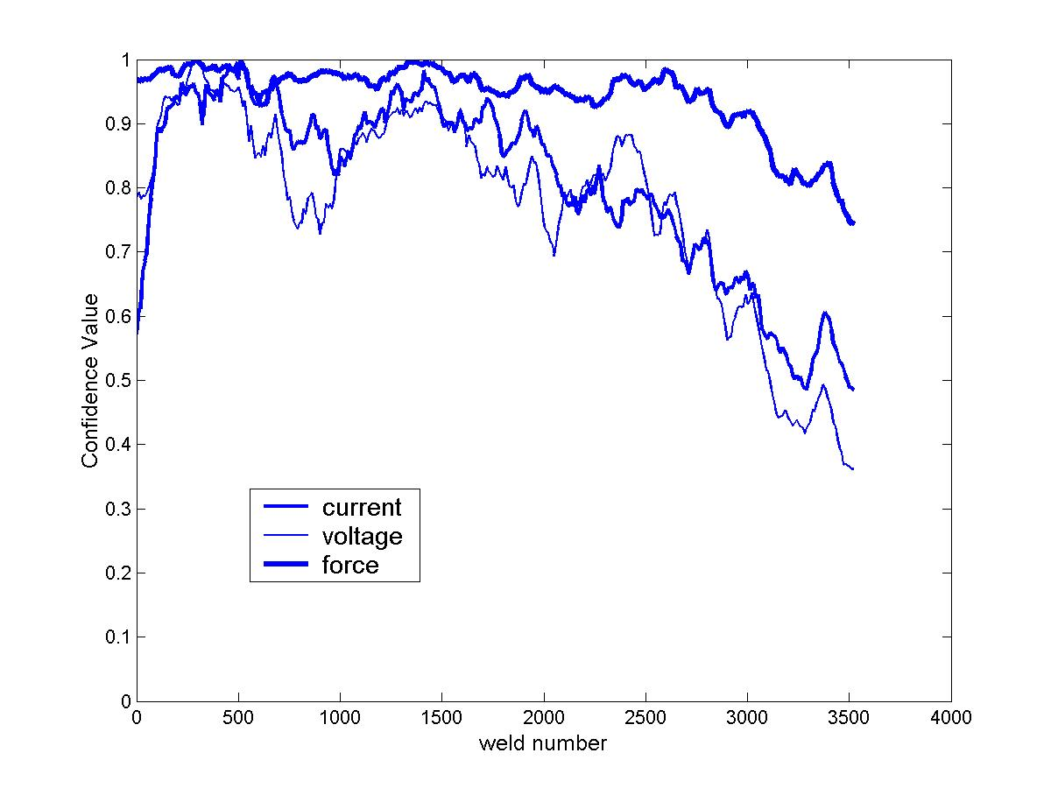
Evolution of Confidence Values (Individual Sensors)
Legend
Wear-in period
Normal Operation
Degradation

Slide 15
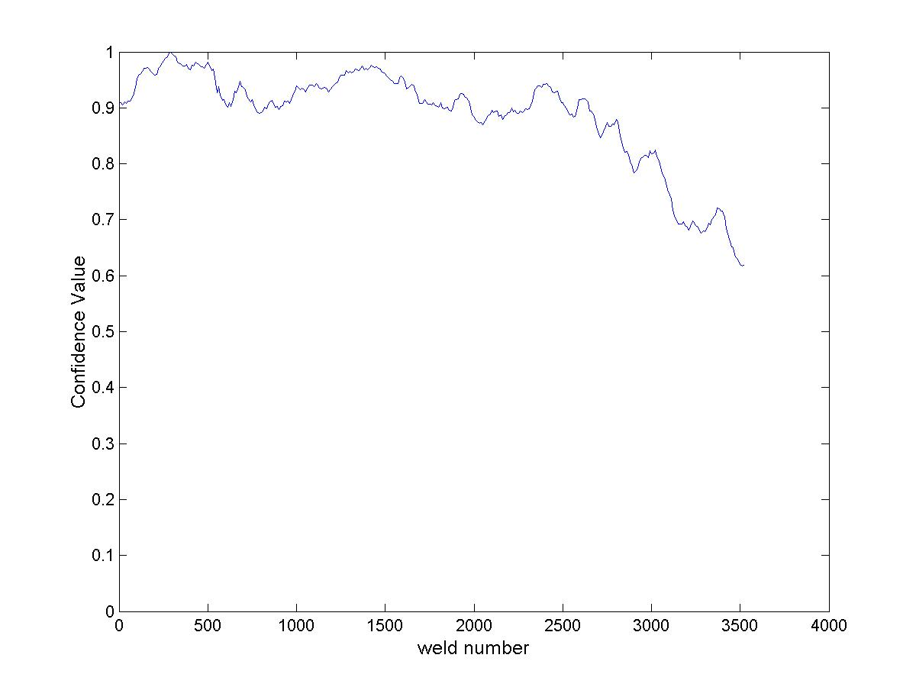
Evolution of Multisensor Confidence Values
Legend
Wear-in period
Normal Operation
Degradation

Slide 16
DISCUSSION
Notes:
Ladies and Gentleman ; Good (Morning Afternoon)!
I am Xue Wang from Tsinghua University , China . Now, I am a visitor scholar in IMS Center UWM.
Today, My presentation topic is Prognostic and Diagnostic

Slide 17
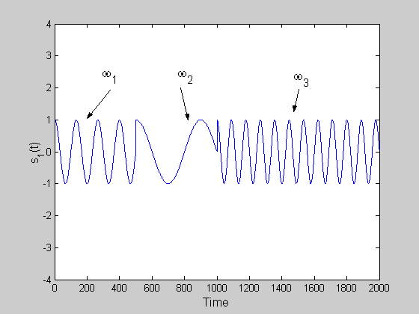
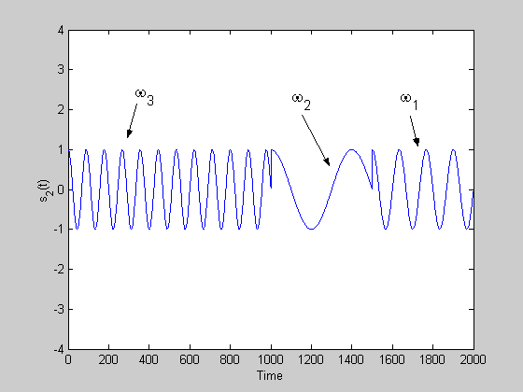
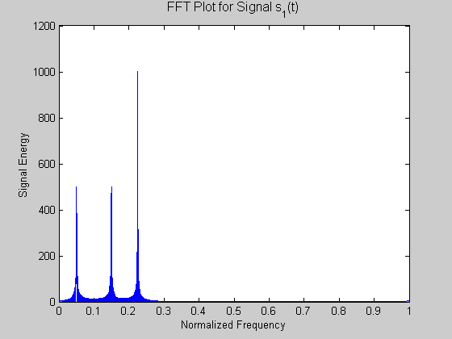

PSDs and Non-Stationary Signals
Power Spectral Density
Power Spectral Density

Slide 18
Limitation of the Methodology
Methodology unable to describe signals with a time-varying frequency content.
Different approach must be used for performance assessment and prediction in the presence of non-stationary signals

Slide 19
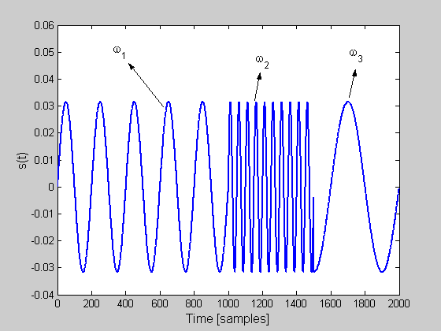
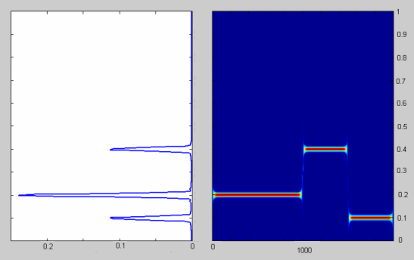
Possible Extension
Performance assessment and prediction in the presence of signals with a time-varying frequency content.
Power Spectral Density
Joint Time-Frequency Distribution
Normalized Frequency
Time [samples]
Signal energy
Time [samples]
What frequencies exist.
When they exist.
What frequencies exist.

Slide 20
Summary
Developed generic methods for quantitative multisensor performance assessment.
Suggested a statistical method for identification of appropriate training signals for describing the normal process behavior.
Experimental validation in multisensor assessment of a welding process.

